Slide 1
IIITB upGrad GDP Analysis
By Prashant Chaturvedi

Slide 2
Part-I: GDP Analysis of Indian States
For each of the following steps of analysis, choose an appropriate type of plot for comparing the data. Also, ensure that the plots are in increasing or decreasing order for better comparison. For e.g., if you make a bar plot to compare the GDPs of various states, ensure that the bars are in either increasing or decreasing order of GDP.

Slide 3

● For the analysis below, use the Data I-A.

Slide 4

Remove the rows: '(% Growth over the previous year)' and 'GSDP - CURRENT PRICES (` in Crore)' for the year 2016-17

Slide 5
Calculate the average growth of states over the duration 2013-14, 2014-15 and 2015-16 by taking the mean of the row '(% Growth over previous year)'. Compare the calculated value and plot it for the states. Make appropriate transformations if necessary to plot the data. Report the average growth rates of the various states: ○ Which states have been growing consistently fast, and which ones have been struggling? ○ Curiosity exercise - what has been the average growth rate of your home state, and how does it compare to the national average over this duration?
From the plot above we can see that States like Mizoram,Tripura and Nagaland are growing at a faster rate
And states like Meghalaya and Odisha are struggling to grow year by year
Since my Home State is Delhi, it is contributing fairly enough (but at a lower rate) to the national average for this duration

Slide 6
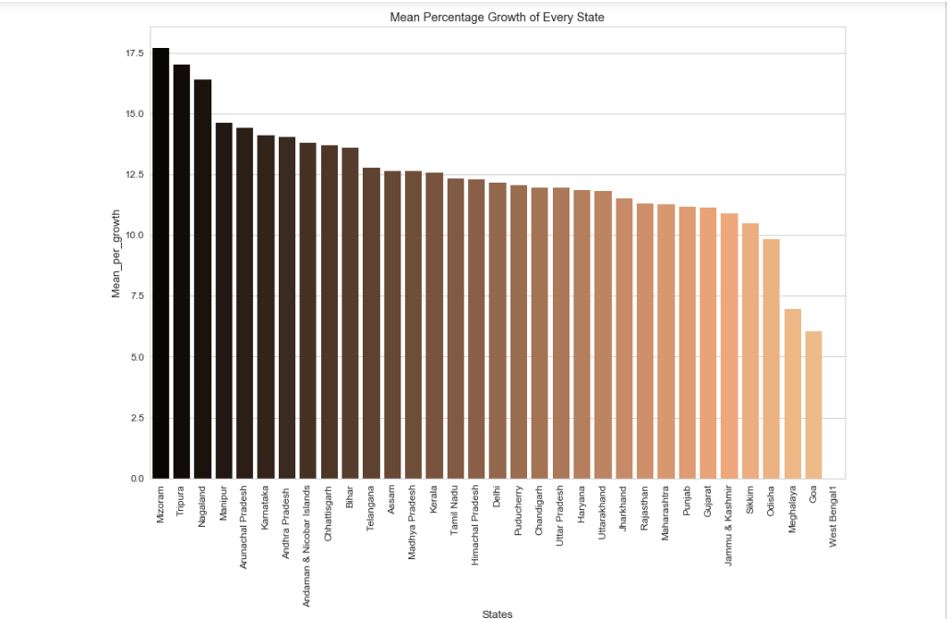

Slide 7
From the plot above we can see that States like Mizoram , Tripura and Nagaland are growing at a faster rate And states like Meghalaya and Odisha are struggling to grow year by year Since my Home State is Delhi, it is contributing fairly enough (but at a lower rate) to the national average for this duration

Slide 8
Plot the total GDP of the states for the year 2015-16: ○ Identify the top-5 and the bottom-5 states based on total GDP
Top 5 States based on GDP are :
Maharashtra
Tamil Nadu
Uttar Pradesh
Karnataka
Gujarat
Bottom 5 States based on GDP are:
Sikkim
Manipur
Nagaland
Mizoram
Andaman & Nicobar Islands

Slide 9
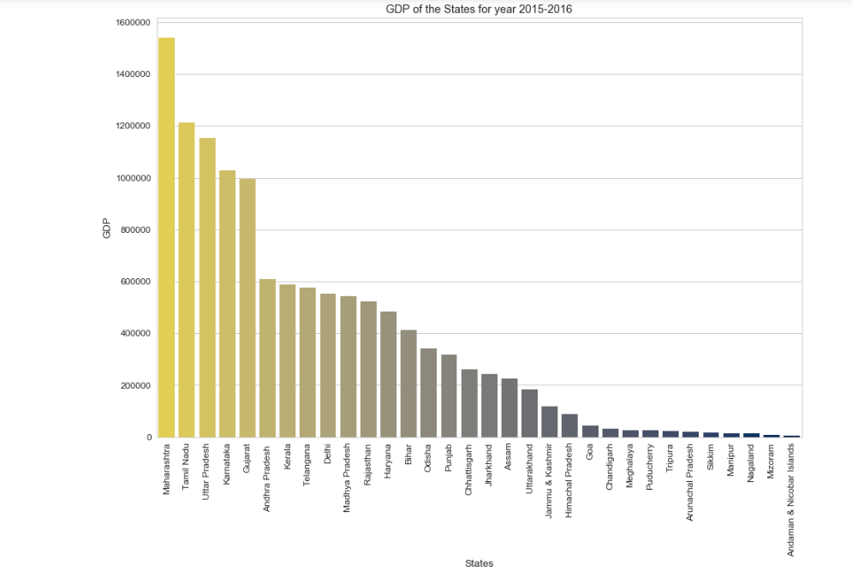

Slide 10
Part I-B:

Slide 11
● Plot the GDP per capita for all the states. ○ Identify the top-5 and the bottom-5 states based on GDP per capita. ○ Find the ratio of highest per capita GDP to the lowest per capita GDP

Slide 12
Top 5 States based on GDP per Capita :
Goa
Sikkim
Haryana
Kerala
Uttarakhand
Bottom 5 States based on GDP per capita :
Jharkhand
Assam
Manipur
Uttar Pradesh
Bihar
Ratio of Top State to Bottom State GDP is :
Top - Goa (271793)
Bottom - Bihar (33954)
8.004 times the GDP of Top State is Higher than the Bottom State

Slide 13
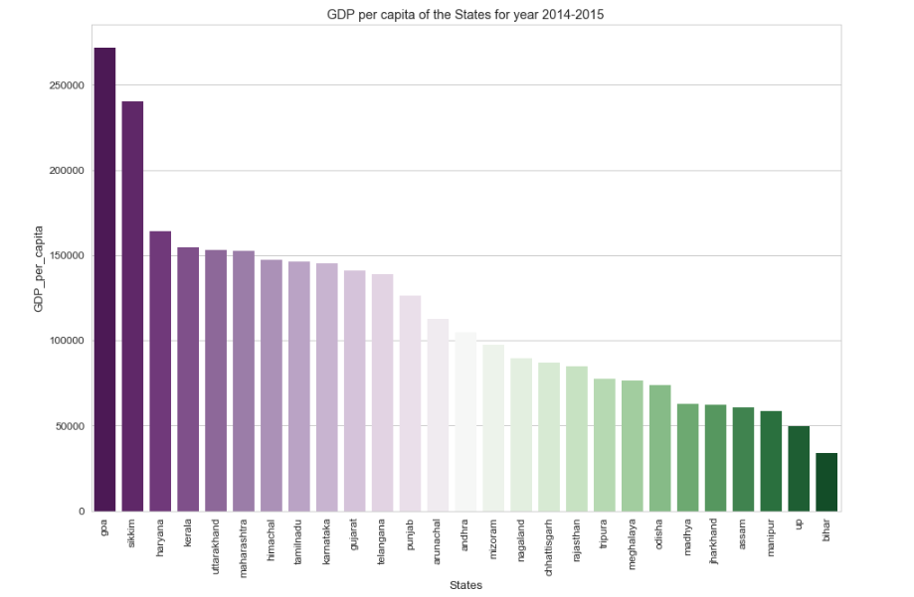

Slide 14
Plot the percentage contribution of primary, secondary and tertiary sectors as a percentage of total GDP for all the states.

Slide 15
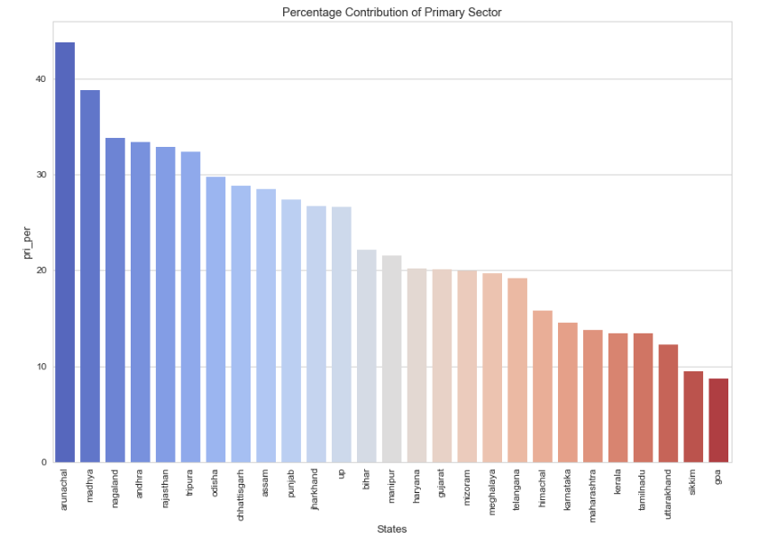

Slide 16
Categorise the states into four categories based on GDP per capita (C1, C2, C3, C4 - C1 would have the highest per capita GDP, C4 the lowest). The quantile values are (0.20,0.5, 0.85, 1), i.e. the states lying between the 85th and the 100th percentile are in C1, those between 50th and 85th percentile are in C2 and so on For each category C1, C2, C3, C4: ○ Find the top 3/4/5 sub-sectors (such as agriculture, forestry and fishing, crops, manufacturing etc.) [not primary, secondary and tertiary] which contribute to approx. 80% of the GSDP of each category

Slide 17
For Category 4 (quantile lower than 0.2) Top Sub-Sectors that are contributing for almost 80% of thte total GDP are: Agriculture Trade and Repair Manufacturing Other Services Construction Real Estate , ownershit etc For Category 3 (quantile between 0.2 and o.5 ) Top Sub-Sectors that are contributing for almost 80% of thte total GDP are:Agriculture Manufacturing Trade and Repair Other Services Public Administration Construction For Category 2 (quantile between 0.5 and o.85 ) Top Sub-Sectors that are contributing for almost 80% of thte total GDP are:Agriculture Manufacturing Rea Estate and ownership Trade and Repair Other Services contruction

Slide 18
For Category 1 (quantile between 0.85 and 1 ) Top Sub-Sectors that are contributing for almost 80% of thte total GDP are:Manufacturing Agriculture Real Estate and ownership Trade ,Repair etc Construction Other Services

Slide 19
Two Recommendations to Increase the GDP per capita : In Category 1, the main focus is in Manufacturing , if the focus is slightly shifted to sector than Manufacturing like , Agriculture and Real Estate, the per capita GDP would definitely increase Also if the focus that is carried in Category 2, if the same strategy is carried out in Category 3 , then also the per capita GDP would rise

Slide 20
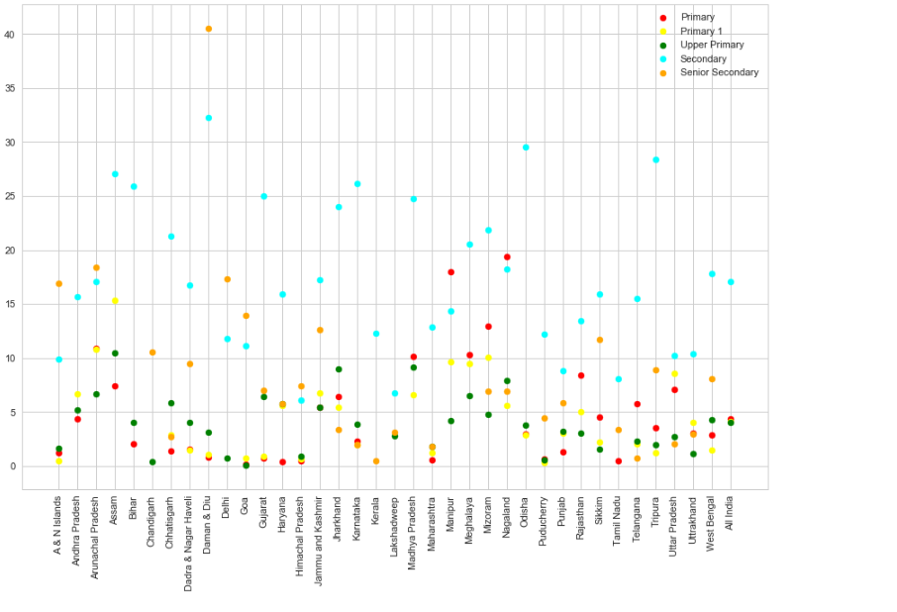
For Part - II

Slide 21
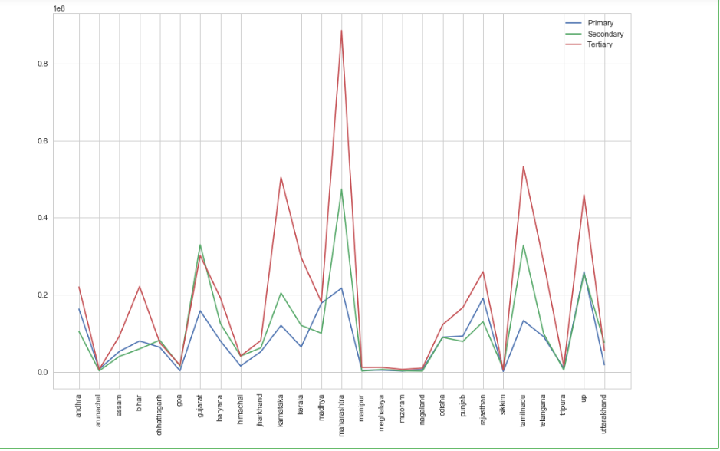
Plotting the GDP for the year 2014-2015

Slide 22
Write the key insights you observe from this data: ○ Form at least one reasonable hypothesis for the observations from the data So if referred both the plots, we can say, as our drop out rates increases, our GDP decreases. We can GDP is highly co-related with the drop out rates, so if there is any increase in the Drop out rates of the education, there will be a tremendus decrease in the GDp for that year Hypothesis that can be made could be : H0 - GDP is not affected by drop out rates H1 - GDp is affected by drop-out rates

Slide 23
Thank You

